Slide 1
BOOKEXCHANGE
Connecting Students. Saving Money. Reusing Books.
ENSE 281 | Scrum 1 Presentation| March 4, 2026

Slide 2
Meet the Team
Thomas P.
Chop Peter
David
Shaikh
GitHub Administrator
Frontend Developer
Project Manager
Lead Developer
QA Lead
Documentation

Slide 3
The Problem
Students spend $1,200+/year on textbooks
Campus bookstore buyback: only 10-20% of original price
No campus-specific platform exists to connect student buyers and sellers
Result:
• Buyers pay full price
• Sellers get almost nothing back
• Books sit unused or are discarded

Slide 4
Our Solution
A web application where students buy and sell
used textbooks directly to each other
📚
💰
♻️
Buyers save
30-70%
Sellers get
fair value
Books get
reused

Slide 5
UML: Use Case Diagram
BookExchange System
Post Book
Listing
Browse
Listings
<<include>>
<<include>>
Search
Books
<<include>>
View Book
Details
Send
Message
Student
Seller
Student
Buyer
Mark as
Sold
Delete
Listing

Slide 6
UML: Class Diagram (MVC Pattern)
Book (Model)
BookController
StorageManager
- id: number
- title: string
- author: string
- courseCode: string
- condition: string
- price: number
- contactEmail: string
- status: string
uses
- storage: StorageManager
1
- STORAGE_KEY: string
manages
+ handleFormSubmit(): void
+ displayBooks(): void
+ handleSearch(): void
+ handleMessage(): void
+ getBooks(): Book[]
+ saveBooks(): void
+ addBook(): void
*
+ markAsSold(): void
+ delete(): void
Message (Model)
- id: number
- bookId: number
- text: string
- timestamp: Date

Slide 7
UML: Sequence Diagram - Post Book
User
post.html
Controller
Storage
LocalStorage
1: fillForm() & submit
2: handleSubmit(data)
3: generateId()
4: addBook(book)
5: setItem(key, data)
6: success
7: return
8: redirect(browse.html)

Slide 8
UML: Sequence Diagram - Send Message
Buyer
details.html
MessagePopup
Controller
LocalStorage
1: click 'Contact Seller'
2: showMessagePopup()
3: typeMessage() & submit
4: saveMessage(bookId, msg)
5: setItem('messages', data)
6: success
7: notify seller
8: show confirmation
Message stored temporarily. Seller gets notification badge. Both can share contact info privately in messages.

Slide 9
System Architecture
High-Level Design
USER (Student Browser)
FRONTEND
HTML: index, browse, post, details | CSS: style.css | JS: script.js
DATA STORAGE (LocalStorage)
Books Array (JSON)

Slide 10
Technology Stack
HTML5
CSS3
JavaScript
Page structure
Responsive styling
Vanilla JS (no frameworks)
LocalStorage
Git/GitHub
VS Code
Browser-based data
Version control
Development environment

Slide 11
Key Features (MVP)
1. Post Book Listing
Form with title, author, course code, condition, price, contact
2. Browse Listings
Grid display of all available books
3. Search Books
Filter by course code or title (case-insensitive)
4. View Details
Complete book info + seller contact
5. Mark as Sold
Remove from browse after transaction
6. Delete Listing
Permanently remove unwanted listings
All processing happens client-side. No backend or server required.

Slide 12
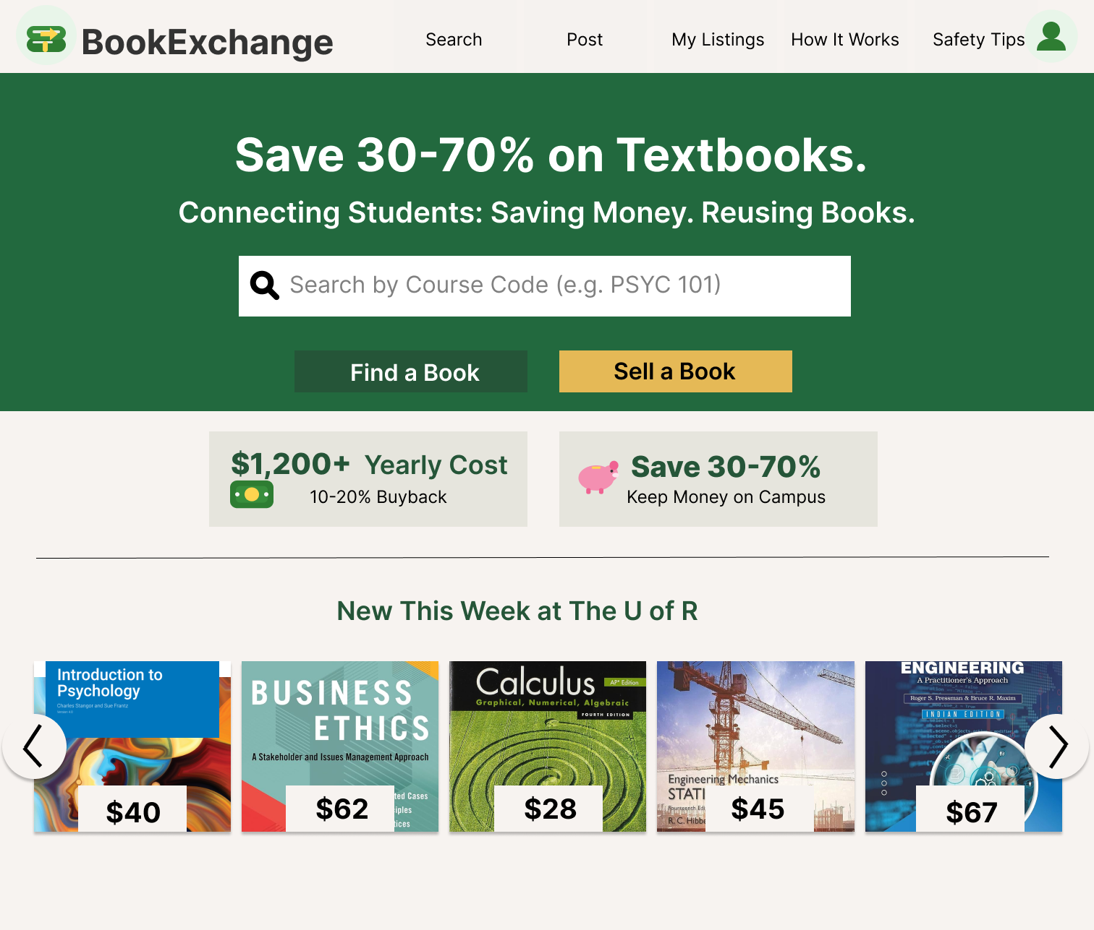
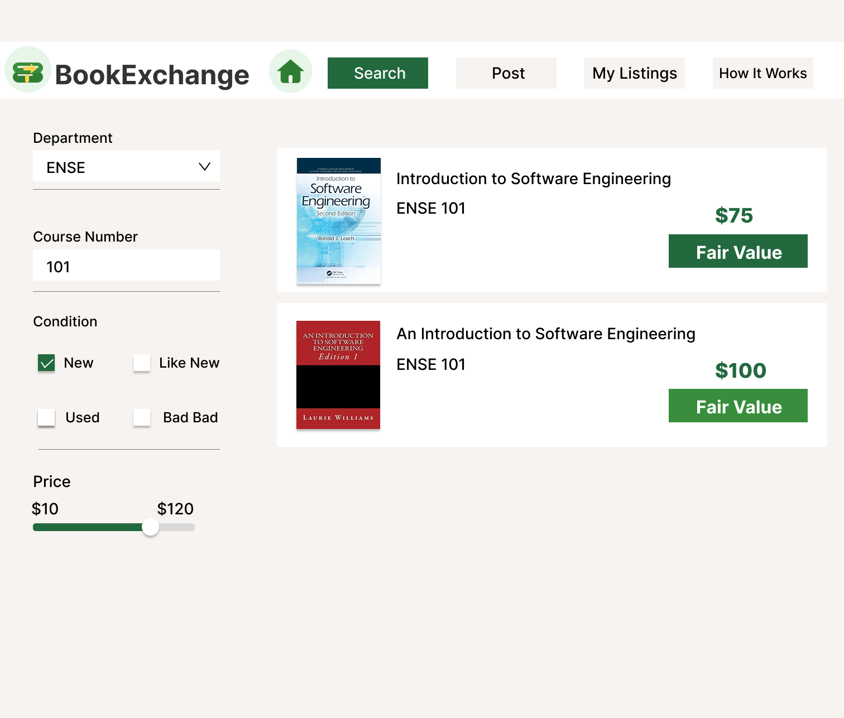
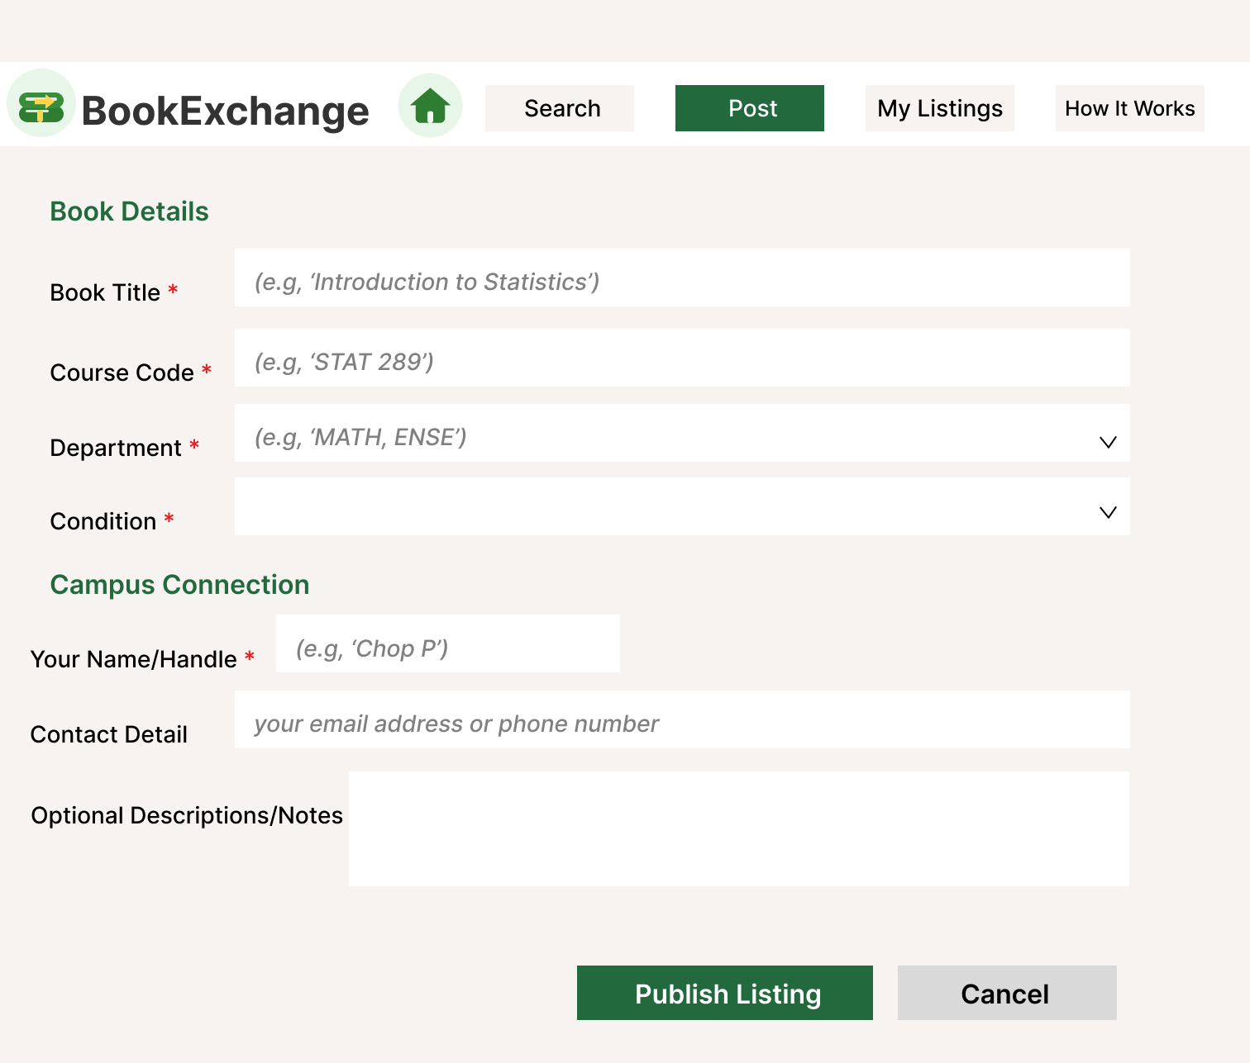
UI Design
Low-Fidelity Wireframes
[Home Page]
[Post Page]
[Details Page]
Welcome + navigation
Form to add listing
Full book info
Note: Mockups designed for desktop and mobile responsiveness

Slide 13
User Flow Example
Scenario: Student buys a PSYC 101 textbook
1
2
3
4
5
Sarah posts
PSYC 101
$60
Mike searches
'PSYC 101'
Views details
+ contact
Emails Sarah
to meet
Exchange
on campus
Result: Thomas saves $90, Sam gets $60 (vs $25 bookstore buyback). Both win!

Slide 14
Challenges & Solutions
Challenge: Privacy Concerns
Displaying seller email/phone publicly raises safety issues
Solution: Considering 'Reveal on Click' for MVP, in-app messaging for future
Challenge: LocalStorage Limitations
Data is browser-specific and can be cleared
Solution: For MVP, accept this trade-off. Future: migrate to Firebase
Challenge: First Web Development Project
Learning curve for team members new to web dev
Solution: Pair programming, regular check-ins, detailed documentation

Slide 15
Self-Reflection
How did you feel about this activity?
It was challenging but rewarding. We enjoyed designing a solution to a real student problem. The scope was manageable, which kept the project from feeling overwhelming.
What is your team most proud of?
Creating a complete system architecture from scratch and organizing our GitHub repository properly. We're also proud of addressing Tim's feedback about privacy concerns thoughtfully.
"We learned that good documentation and planning upfront saves time later in development."

Slide 16
Self-Reflection (Continued)
What did you learn about yourself?
We learned the importance of clear communication and task division. Using the RACI chart helped us understand our roles. We also learned to be comfortable asking for help when stuck.
How will you use what you learned going forward?
We'll continue using Git best practices, proper documentation, and systematic planning. The experience of building something from requirements to architecture will help in future projects.
What would you like more help with?
Best practices for handling user privacy and data security. Also guidance on when to add features vs keeping scope minimal for MVP.

Slide 17
Next Steps
Immediate (This Week)
• Implement HTML/CSS for all 4 pages
• Begin JavaScript functionality
• Create UI mockups in Figma
Short-term (Next 2 Weeks)
• Complete all 6 core features
• Test with sample data
• Address privacy concerns
Future Enhancements
• Migrate to Firebase for real database
• Add user accounts and authentication
• Implement in-app messaging

Slide 18
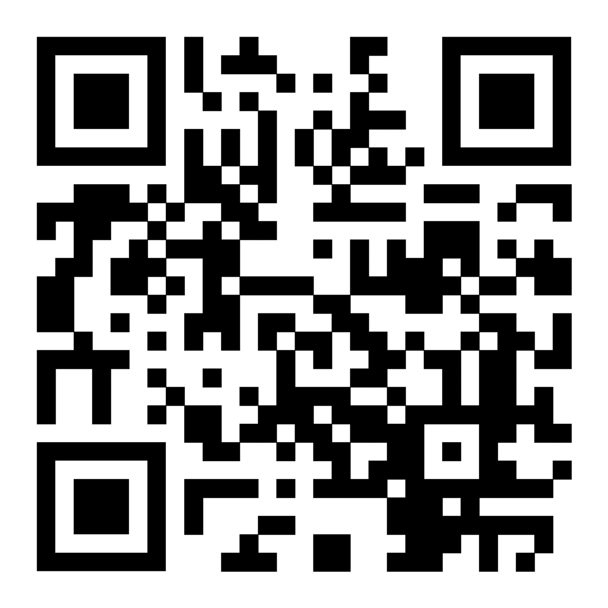
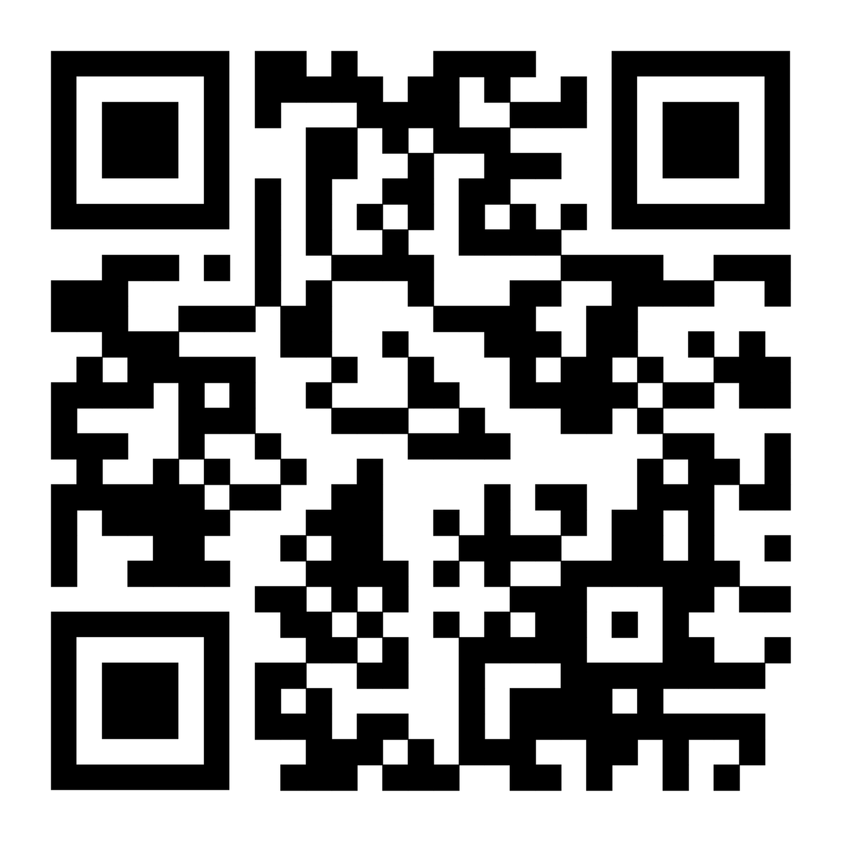
Feedback
Prototype:
Google Form:
We would like to get YOUR feedback on our current website design. Please check out our prototype and fill out this google form. —>
Please

Slide 19
Thank You!
Questions?
GitHub: github.com/thomaskeithpersson-afk/281-Group-Project

